Slide 1
Resources Workshop Attendees
DO cancer slim Raja Mazumder, Lynn Schriml, Elvira Mitraka
NCBI Donna Maglott
EBI Sira Sarntivijai
NCI EVS Sherri de Coronado
MGI Sue Bello, Judy Blake, Janan Eppig, Debbie Krupke, Cynthia Smith
PRO Judy Blake, Cathy Wu
NCI Genomic Data Commons Mark Jensen
EDRN Maureen Colbert

Slide 2
Disease Ontology (DO) Cancer Project DO_Cancer_Slim version 1.0
SOURCE: COSMIC, TCGA, ICGC, TARGET, IntOGen, EDRN
386 original cancer terms (w/o benign)
Mapped to 187 DO child node terms
63 (59 organ system & 4 cell type) top-level DO cancer terms
Wu TJ, Schriml LM, Chen QR, Colbert M, Crichton DJ, et al. 2015. Generating a focused view of disease ontology cancer terms for pan-cancer data integration and analysis. Database (Oxford). 2015:bav032.
Notes:
The Catalogue of Somatic Mutations in Cancer (COSMIC), The Cancer Genome Atlas (TCGA), International Cancer Genome Consortium (ICGC), Therapeutically Applicable Research to Generate Effective Treatments (TARGET), Integrative Oncogenomics (IntOGen) and the Early Detection Research Network (EDRN)

Slide 3
In Progress DO_Cancer_Slim version 2.0
SOURCE: COSMIC, TCGA, ICGC, TARGET, IntOGen, EDRN, ClinVar
3343 original cancer terms (with DNA mutation counts, and w/o benign)
81 (71 organ system & 10 cell type) top-level DO cancer terms (most terms)
Notes:
Distinguish sub-sources of ICGC:
ICGC specific terms of ICGC
ICGC-TARGET terms that ICGC extracted from TARGET
ICGC-TCGA terms that ICGC extracted from TCGA
Google Sheet link for the new version:
https://docs.google.com/spreadsheets/d/1iKZSC1CzSMMedJrJFmhpXrcPhZ6j7o7unbL5EhSYNK0/edit#gid=0
By the end of summer we hope to finish mapping

Slide 4
Application of Cancer-DO Slim terms
For pan-cancer analysis across datasets from multiple sources → providing better annotation, data integrations and mining capabilities
BioXpress: Human gene expression data related to cancer, 26 cancer-DO slim terms (https://hive.biochemistry.gwu.edu/tools/bioxpress)
BioMuta: Human cancer associated single-nucleotide variations, SNVs, 26 cancer-DO slim terms (https://hive.biochemistry.gwu.edu/tools/biomuta)
Example usage of BioMuta: Human germline and pan-cancer variomes and their distinct functional profiles. PMID: 25232094)
Mapped cancer terms enable integrative analysis of expression and mutation data
Allows better organization leading to better search and browsing capabilities of genomic data

Slide 5
Our challenges
Criteria for classification (organ/cell type/cancer causes/anatomy)?
How many levels of DO child terms are needed?
Abbreviations of cancer slim terms needed to be unified?
Resources that have mutation/expression data which is mapped to multiple cancers. How to integrate such data
e.g. Breast-ovarian_cancer (map to Breast cancer & Ovarian cancer? Will this lead to errors? Any need for joining terms?)
e.g. Lynch_syndrome|Endometrial_carcinoma (Lynch syndrome is autosomal dominant (DOID:3883), increasing the risk of many types of cancer, classify as benign not worry about it for the cancer slim project?)
Notes:
Examples:
http://www.ncbi.nlm.nih.gov/clinvar/variation/52160/ http://www.ncbi.nlm.nih.gov/clinvar/?term=Familial_cancer_of_breast+Breast-ovarian_cancer+familiar+1
2) http://www.ncbi.nlm.nih.gov/clinvar/variation/89312/ http://www.ncbi.nlm.nih.gov/clinvar/?term=Lynch_syndrome+Endometrial_carcinoma (This is a link to all mutations having this term)

Slide 6
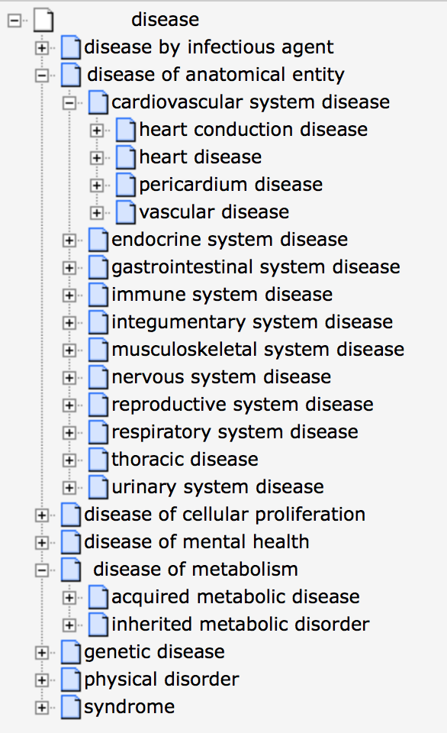
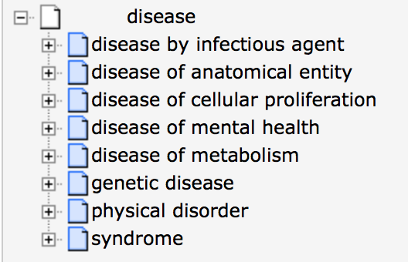

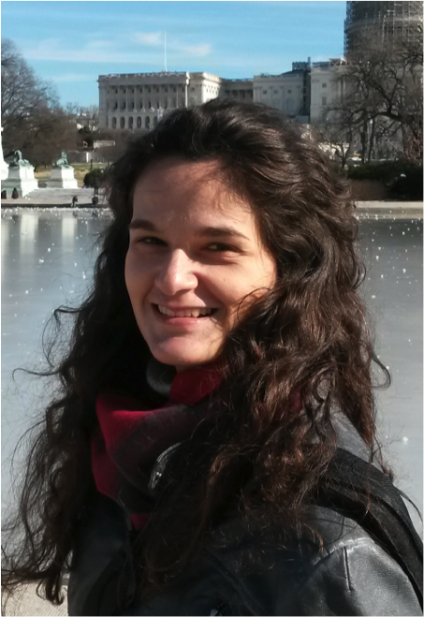
Human Disease Ontology
http://www.disease-ontology.org
Lynn M. Schriml Elvira Mitraka
University of Maryland, School of Medicine
Institute for Genome Sciences
6,570 disease terms (38% defined)
37,988 xref mappings
Notes:
human disease – classified by disease etiology
Broadly used.

Slide 7

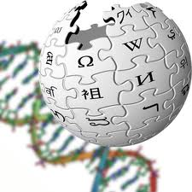






NIH/NIGMS R01 GM089820
Genes – Diseases – Drugs
1,600 terms
Wikidata #’s: 5,512 terms
Gene Wiki
Wikidata:
creation of ~2,500 common disease
& the ~4,000 rare disease
Disease classification by etiology
DO_Cancer slim
(393 terms)
NCI, COSMIC, TCGA, GW: Raja Mazumder
510 genetic diseases
DO_MGI_slim
DO web: 1,380/month
BioPortal: #3, 896 hits in 01/2015
1,226 pathways and reactions & 2,167 proteins and complexes
3296 OMIM IDs – 1152 DOIDs
Notes:
Disease Ontology:
data sources, data contributors, harmonizing disease terms
Genes, diseases and drugs

Slide 8
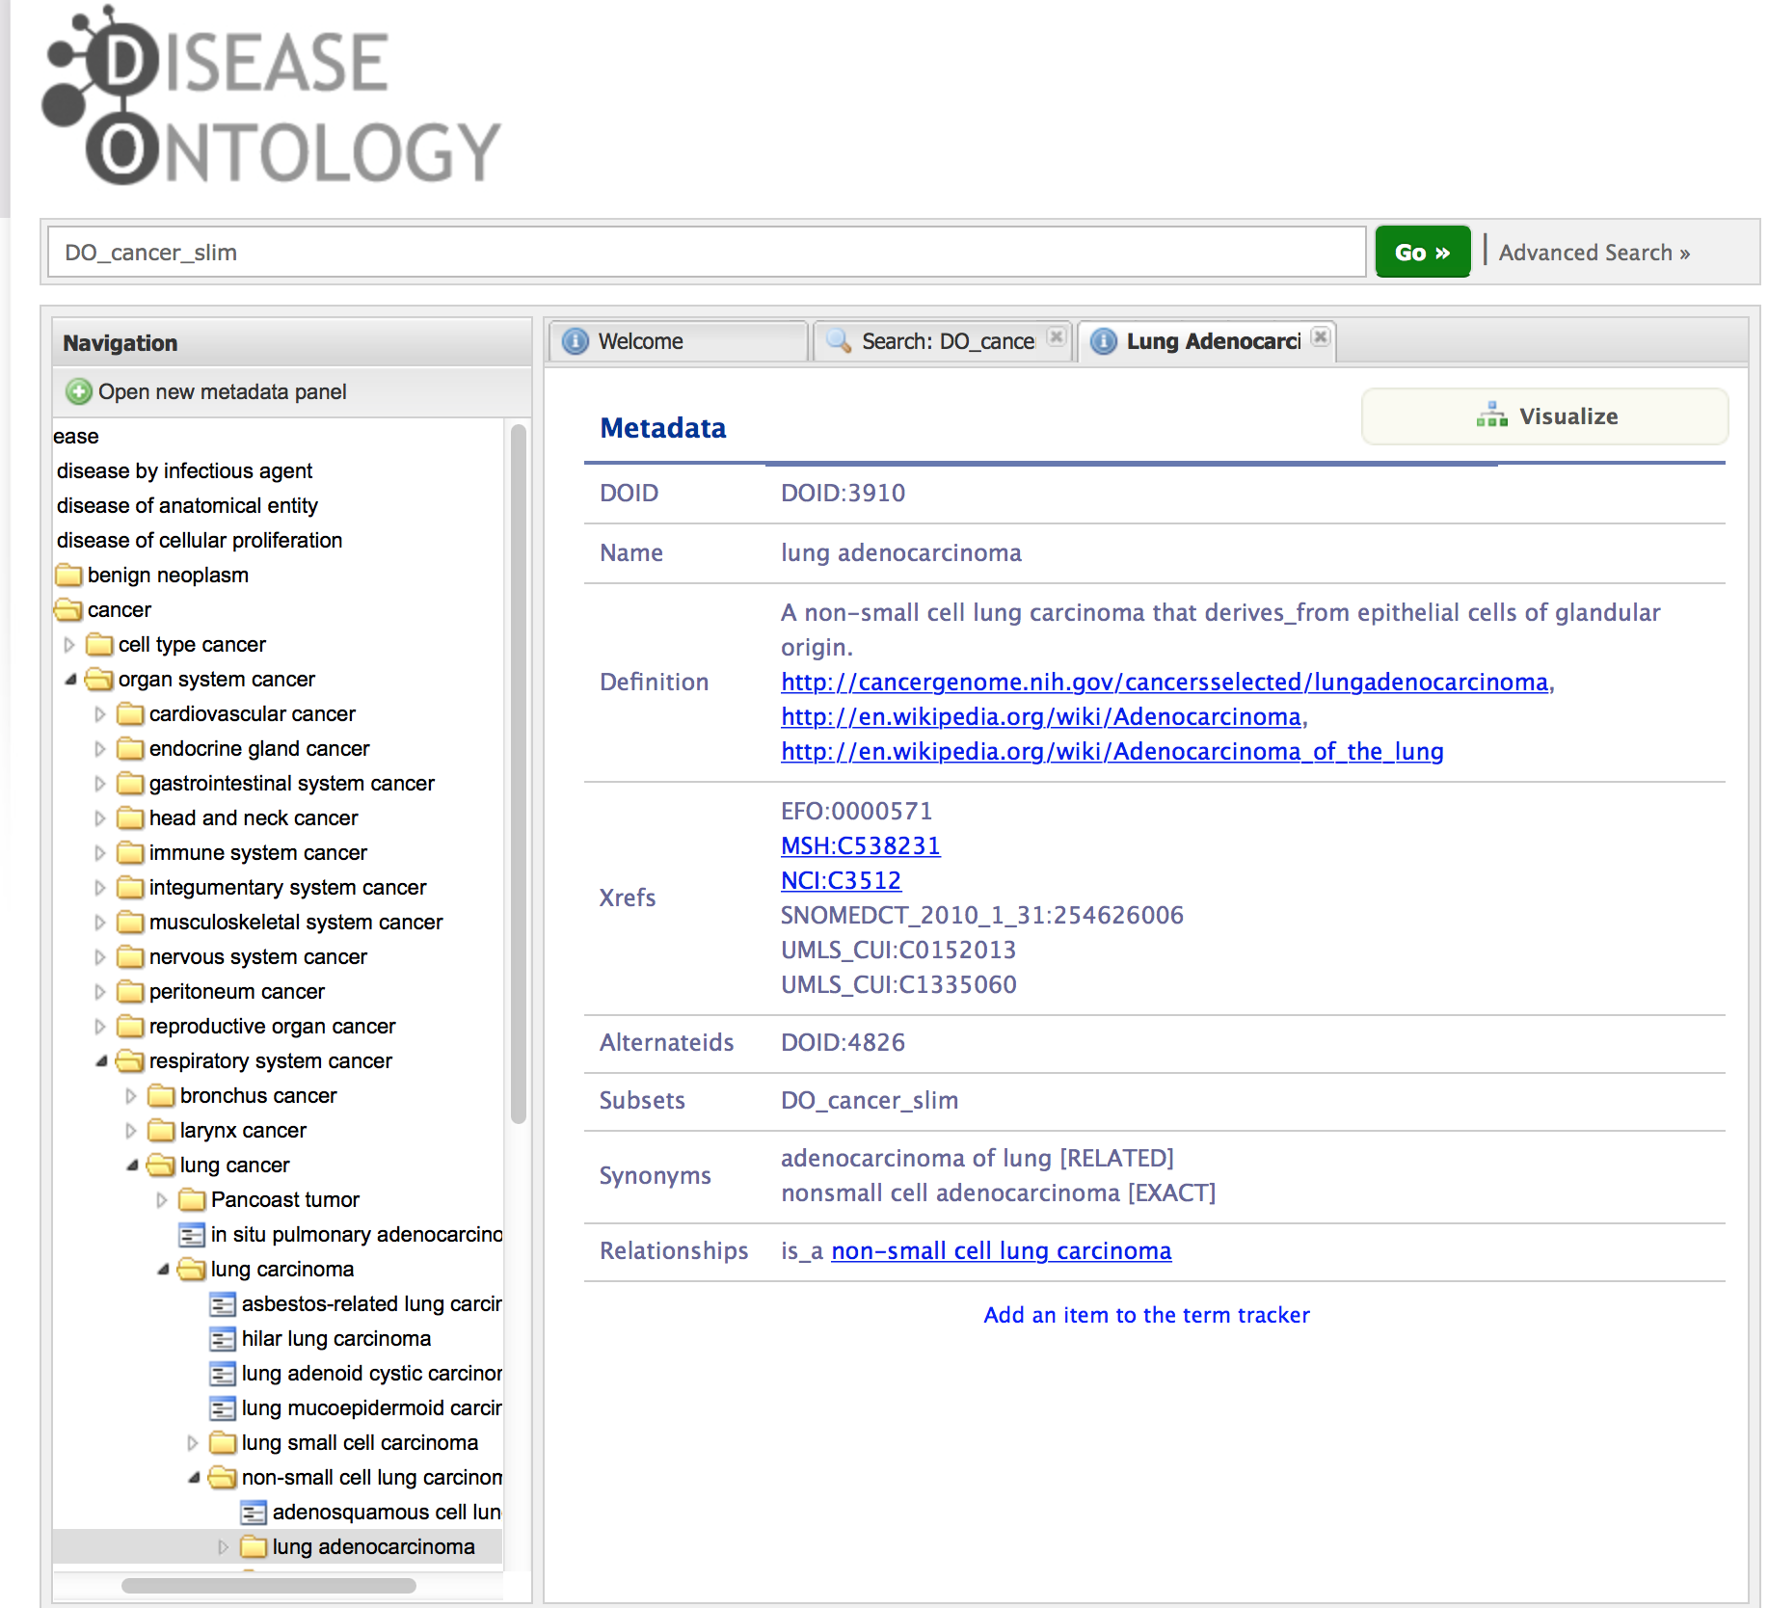

Slide 9







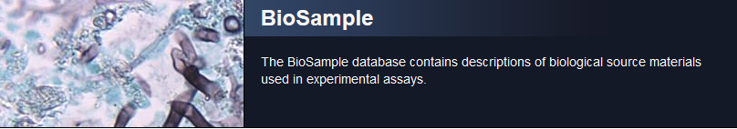
There are multiple databases at NCBI that manage information about cancer. In addition to GTR, ClinVar, and MedGen, which are covered in the next slides, PubMed, dbGaP and ClinicalTrials use MeSH,
and databases, such as Biosample and its linked databases, use what the submitter provides for metadata until resources can be established to map the content to standard values.

Slide 10
Disease vocabularies in ClinVar, GTR, and MedGen
Vocabulary (or not) | Summary
Terms from submitters to GTR or ClinVar | Many testing laboratories or researchers do not maintain disease names referenced to a standard vocabulary, so staff suggest a standard term for submissions, but ClinVar does not require standardization for submission.
Many via UMLS, e.g. MeSH, SNOMED CT, NCIt, HPO | http://www.ncbi.nlm.nih.gov/medgen/docs/definitionsources/
OMIM®/ HPO | Disease names and observed phenotypes from OMIM and HPO are in UMLS, but not updated often enough for ClinVar and GTR to use. So MedGen integrates terms as released from the data source, and reconciles with UMLS with each UMLS release
Orphanet / ORDO | Use both the formal ontology and the list of terms
PharmGKB | In progress
Curation: There are limited resources within ClinVar, GTR, and MedGen to map terms from one vocabulary to another. The most frequent curatorial activities are to educate submitters about existing vocabularies, and to override mappings in UMLS for OMIM, namely to separate general terms (OMIM’s phenotypic series, many terms from Orphanet) from gene-specific ones and connect to general terms from SNOMED CT. There are also efforts coordinated with ClinGen to review gene-disease relationships.

Slide 11
Curator challenges
Definitions
There are many classification schemes for families of disorders. For a curator to evaluate the appropriateness of a term with a submitter/end user, especially as compared to another one, it is critical to have a clear definition of each term (almost a differential diagnosis).
Mappings
There are almost as many mapping efforts as there are sources of vocabularies. When source A states disease D1 is a subset of D2, and source B treats D1 as a synonym of D2, and source C treats D1 as a sibling of D2, how can these be resolved (assuming we know sources A, B, and C each define D1 and D2 the same way)?
Education
Many end users do not consider how the terms they want to use might related to public vocabularies or ontologies. Explaining why choices matter for future computational analyses or data retrieval takes time.

Slide 12

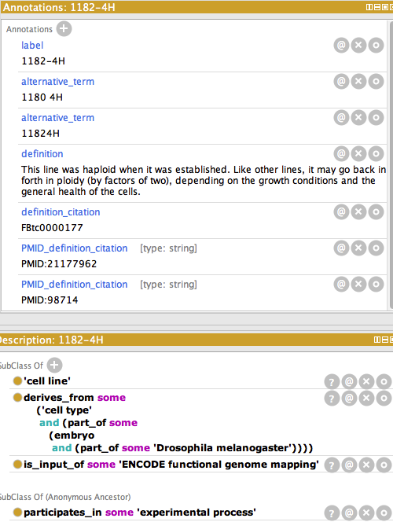
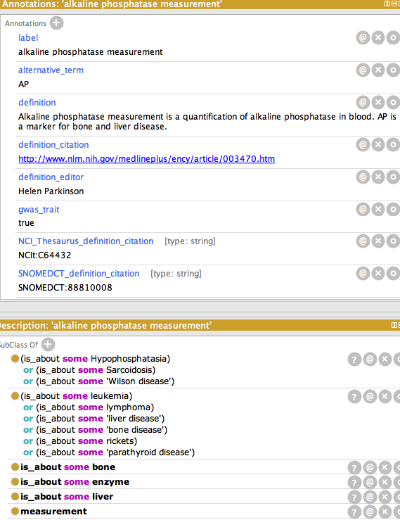
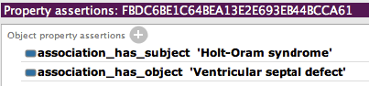
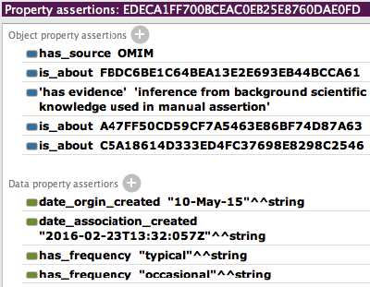
http://www.ebi.ac.uk/efo/
EFO 2.70 (March 2016) contains 17968 classes, 30625 logical axioms
Application ontology containing patterns that describe experiments; e.g. cell lines, measurements, diseases-phenotypes OBAN (tinyurl.com/jbmsoban)
disease-phenotype association
cell line
measurement
provenance

Slide 13
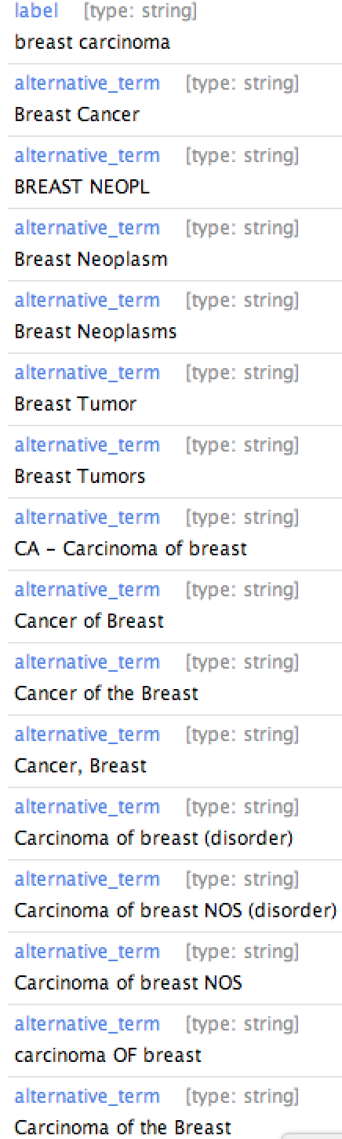
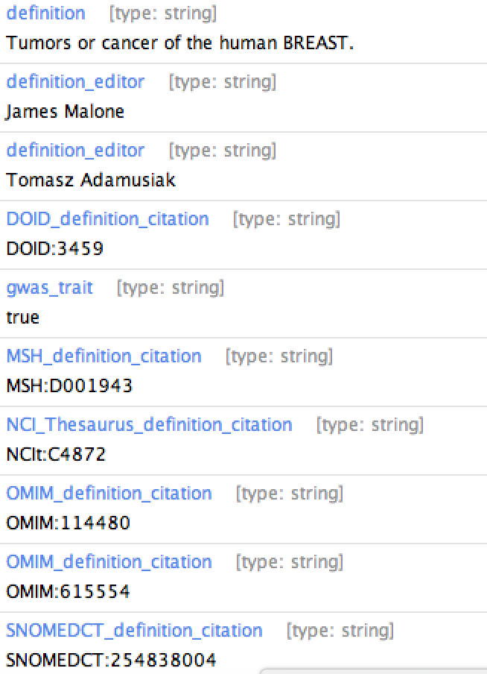
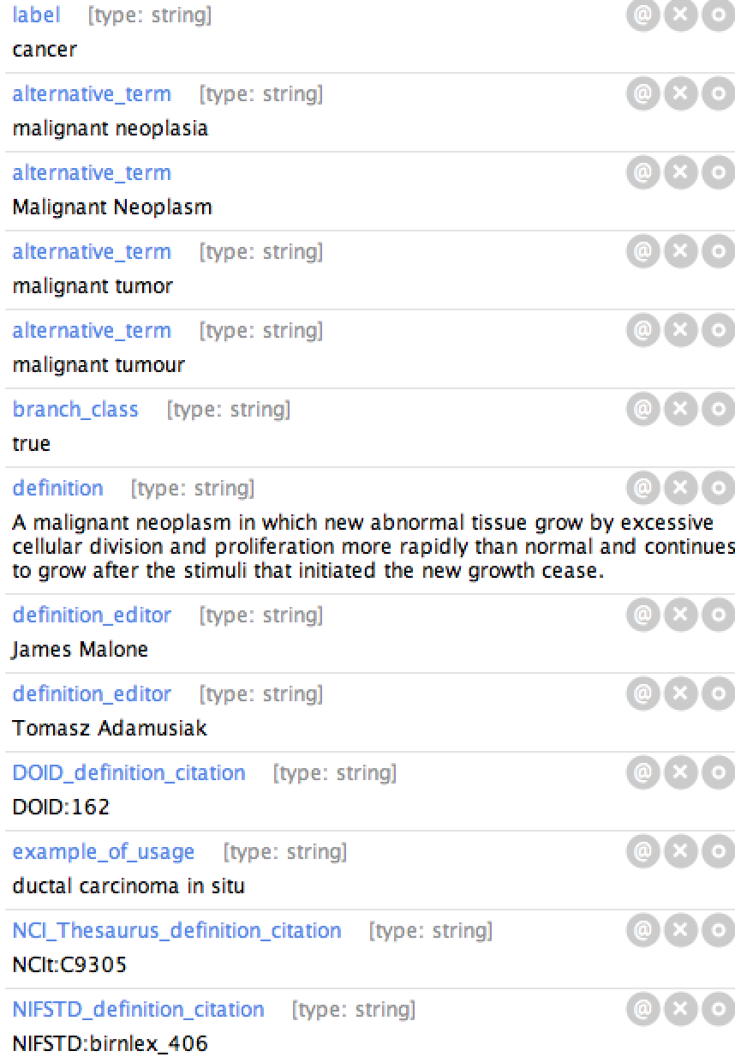
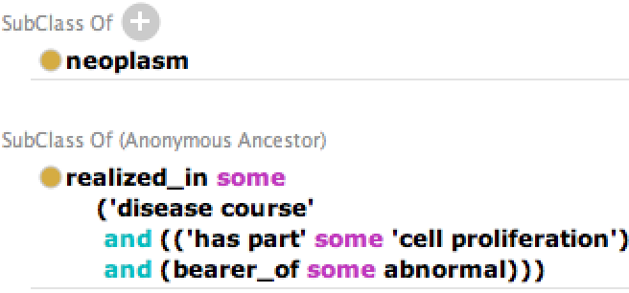
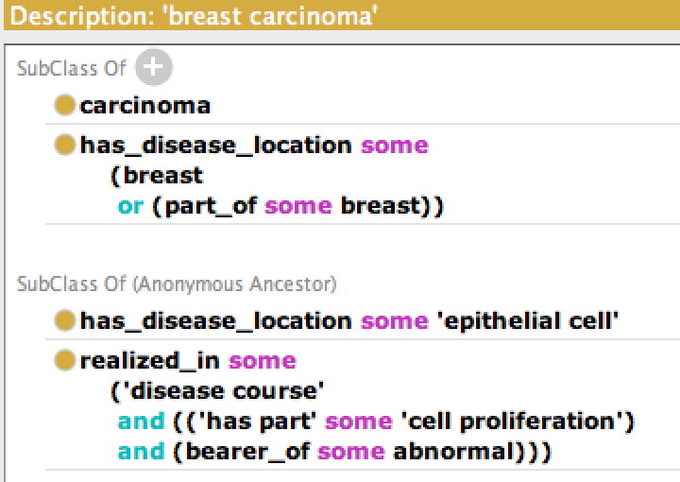
EFO links different ontologies via axiomatisation
UBERON
CL
OGMS
GO
PATO
Notes:
Semi-automated mining of information, heavily manually curated for QC. Clinical terms are messy, thus coverage by alternative terms and xRefs to many disease resources. Design pattern to link across multiple domain ontologies.

Slide 14
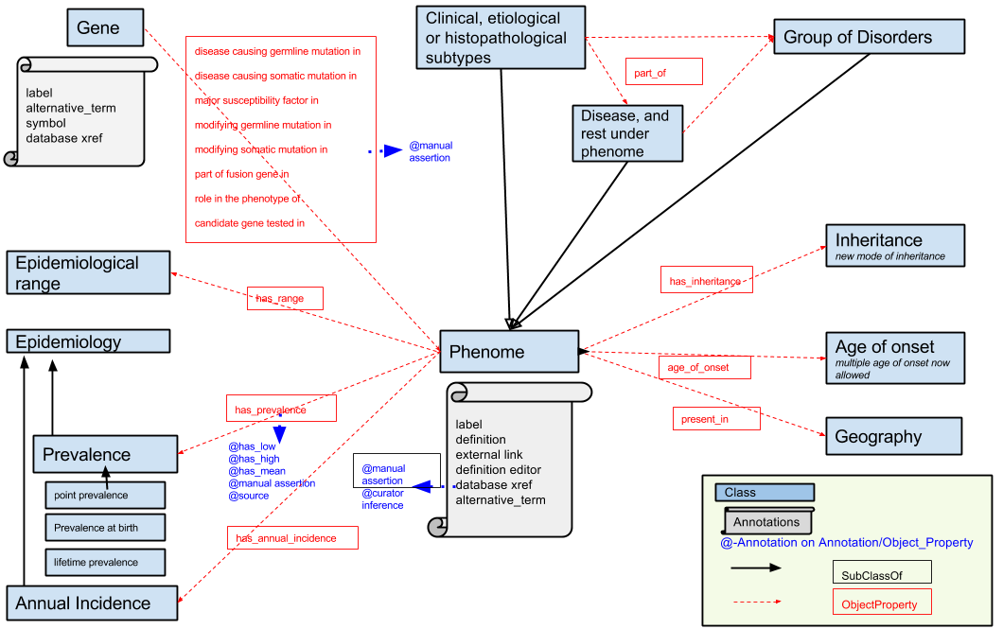
Challenges in axiomatising rare diseases
Inconsistent design patterns in different disease terminology structures
Can we share a compatible design pattern with compatible representation (e.g. OBAN used in HP, EFO, Monarch initiative) ?
Notes:
has_range, has_prevalence, has_annual_incidence, has_inheritance, age_of_onset, present_in are being transformed to OBAN model. Disease has_disease_location UBERON:anatomical part, disease realized_in ‘disease course’ has_part GO:process and bearer_of PATO:abnormal are being implemented. If we can share these disease design patterns, shuttle across different disease ontologies will be easier and consistent. The design patterns are compatible with HP’s implementation (Phenotype as quality, disease as disposition --- the object properties domain-range will work).

Slide 15
Summary Facts: NCI Thesaurus and EVS (Enterprise Vocabulary Services)
Disease Ontology Workshop: Geneva April 2016
Sherri de Coronado, Larry Wright
NCI EVS

Slide 16

EVS Purpose and Scope
Since 1997, EVS has addressed practical needs of NCI and the research community for terminology and ontology services, ranging from mundane coding to cutting edge science and semantics.
Encode Precise, Stable Meanings:
Support best-practice, science-based, quick-response terminology/ontology resources to help researchers accurately collect, code, and analyze data.
Support Semantic Infrastructures:
Support metadata, models, value sets, and mappings that provide broader, computable representations to structure meanings and make them interoperable.
Build Shared Standards:
Partner and harmonize with other NIH ICs, agencies like FDA, international standards organizations like CDISC, and researchers in creating and improving shared standards for increasingly international, cross-cutting research.
Promote Open Content and Tools:
Promote open access, open source content and tools to lower barriers, share burdens, and build shared resources.
EVS is integral to many NCI efforts, from basic research and clinical trials to precision medicine, big data, and the cancer moonshot.

Slide 17
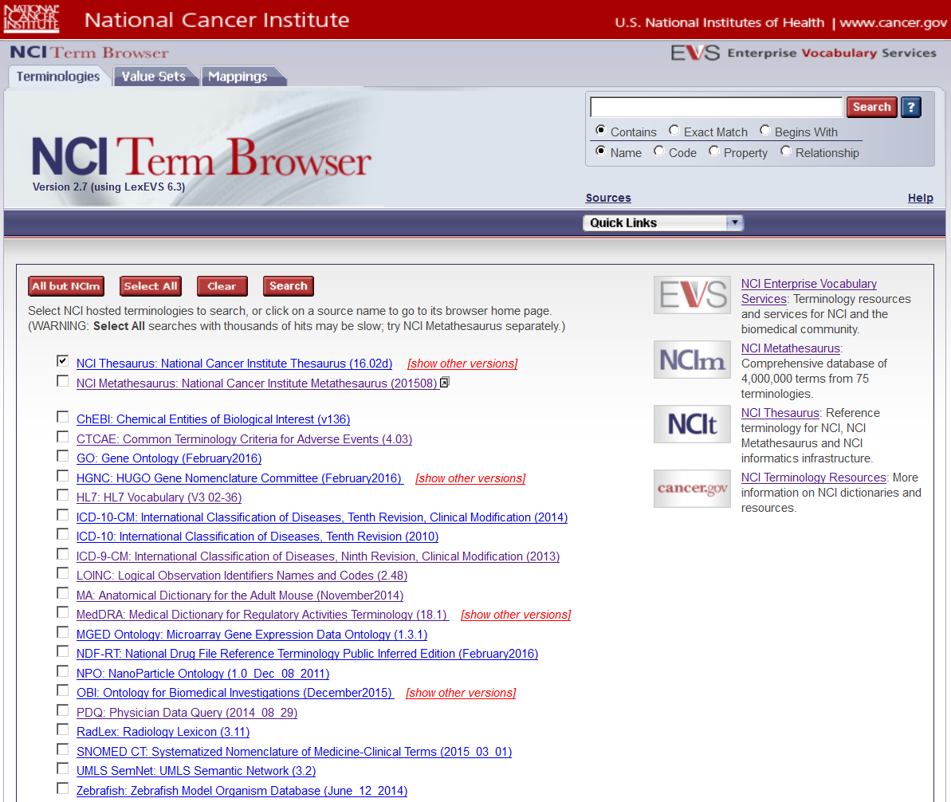
NCI Unified, Open Infrastructure LexEVS Server & NCI Term Browser http://nciterms.nci.nih.gov/
3 Resource
Types
Search
25 / 75 Subsources
22 Sources
Linked Resources

Slide 18
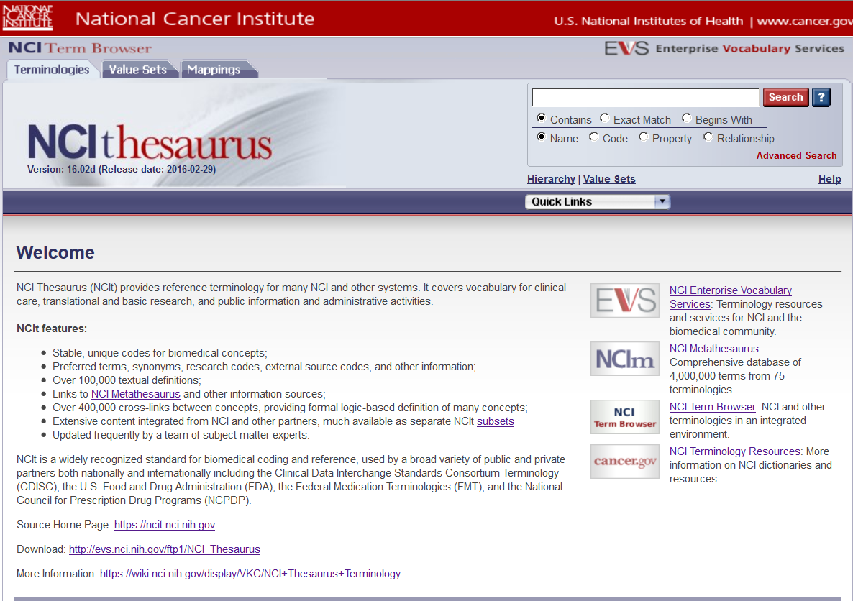
NCI Thesaurus (NCIt) Browser: https://ncit.nci.nih.gov
110,000+ concepts
100,000+ definitions
400,000 relationships
25 partners/ subsources

Slide 19
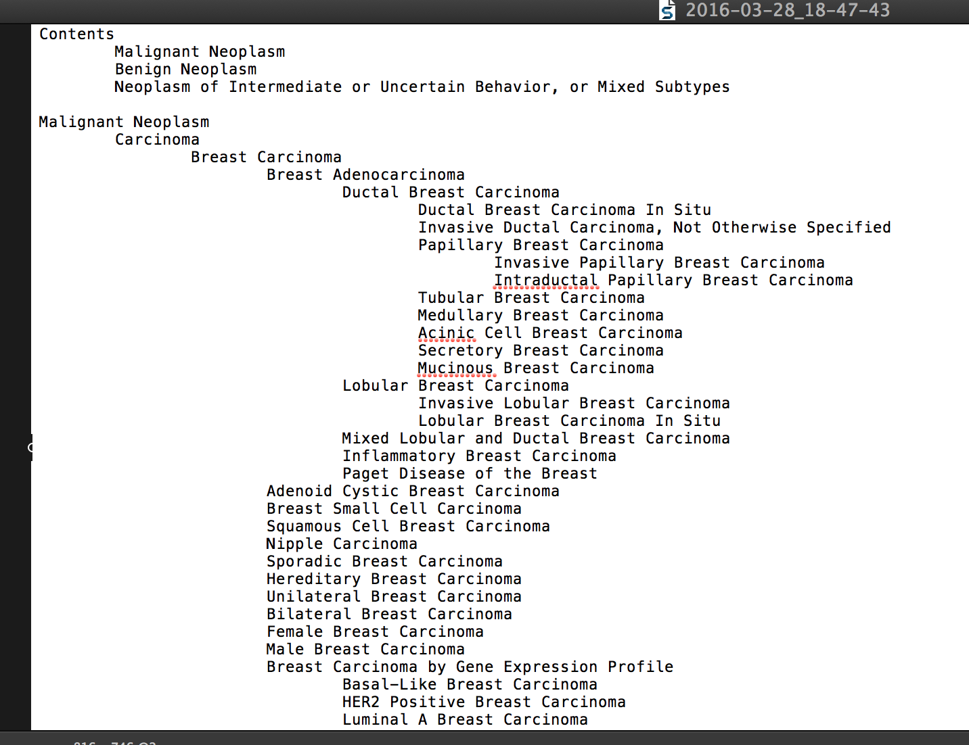
NCIt Neoplasm Core Subset – in progress
Purpose: Core reference set of NCIt neoplasm classification concepts to facilitate consistent coding, analysis, and data sharing across a broad range of NCI and related resources.
Includes: all neoplasms frequently encountered in research and clinical settings, perhaps 80% of infrequent/rare neoplasms encountered in such settings. And roughly 60% of the specific histopathologic variants of malignant neoplasms.
⬅
Notes:
NCI Neoplasm Core Value Set
Draft Overview - 3/24/2016
Purpose: This core reference set of NCIt neoplasm classification concepts will facilitate consistent coding, analysis, and data sharing across a broad range of NCI and related resources.
Background: NCIt provides NCI’s comprehensive cancer classification terminology and ontology, and NCIm provides cross-mappings to many related terminologies of interest to the NCI community. NCIt includes rigorous human and machine readable definitions of many thousands of distinct types of neoplasm, organized in logic based parent-child hierarchies. NCIt is used in many NCI and other systems around the world for cancer research, care, and reference, and is useful in interpreting and translating information from many other resources.
Organization: The need has long been felt for a smaller core reference set of cancer classification terms that are most commonly used for research, care, and public health purposes. This draft set includes 1,352 neoplasm concepts out of the 8,301 currently in NCIt. Where possible, concepts are only listed once, but some dual listing means that the initial rough draft has 1,551 rows.
The draft set includes all neoplasms frequently encountered in research and clinical settings, and perhaps 80% of infrequent/rare neoplasms encountered in such settings. Beyond that, it includes roughly 60% of the specific histopathologic variants of malignant neoplasms. Some may appear obscure, but about 70% of these concepts have tracked use in NCI’s main clinical trial and metadata repositories.
This set will be made available in multiple views, but integrated in NCIt to cross-walk to more detailed classifications, ontology, terminology mappings, and links to key cancer information resources. The initial draft list is organized under 3 main headings:
Malignant Neoplasm
Benign Neoplasm
Neoplasm of Intermediate or Uncertain Behavior, or Mixed Subtypes
NCI is exploring opportunities to actively enhance and facilitate use of this reference set.

Slide 20
EVS Resources
Web & Wiki Pages:
EVS Web Portal: http://evs.nci.nih.gov/
EVS Wiki: https://wiki.nci.nih.gov/display/EVS/EVS+Wiki
EVS Bibliography: https://wiki.nci.nih.gov/display/EVS/Bibliography+on+EVS+and+Its+Use
EVS Use & Collaborations: https://wiki.nci.nih.gov/display/EVS/EVS+Use+and+Collaborations
Browsers and Term Request:
NCI Term Browser: https://nciterms.nci.nih.gov/
NCI Thesaurus: https://ncit.nci.nih.gov/
NCI Metathesaurus: https://ncim.nci.nih.gov/
NCI EVS Term Request Page: https://ncitermform.nci.nih.gov/
EVS/NCIt Staff email: NCIThesaurus@mail.nih.gov

Slide 21

Mouse Genome Informatics www.informatics.jax.org
Projects using tumor and cancer related terms:
Mouse Tumor Biology (MTB) Database
Annotate tumor diagnoses reported in mouse cohorts
Uses a custom tumor vocabulary
Uses a custom anatomy vocabulary based on the Adult Mouse Anatomy Ontology for organ tissue location
Mouse Genome Database (MGD)
Annotate tumor incidence, susceptibility in populations of mice
Uses Mammalian Phenotype Ontology terms
(logical definitions use MPATH for now, considering NCIT)
Annotate mouse models of human disease
Uses OMIM disease terms
Notes:
logo and url
different symbols for levels

Slide 22
Mouse Genome Informatics www.informatics.jax.org
Vocabulary Issues
MTB
Issues with Tumor Diagnosis Vocabulary
maintenance
lack of structure
MGD
Issues with OMIM
lack of structure
absence of many generic cancer disease terms
MGI
Need to distinguish between tumors, tumor related phenotypes, and diseases
No cross relationships between tumor diagnoses, phenotype and disease vocabularies
Notes:
add logo
bullet levels

Slide 23


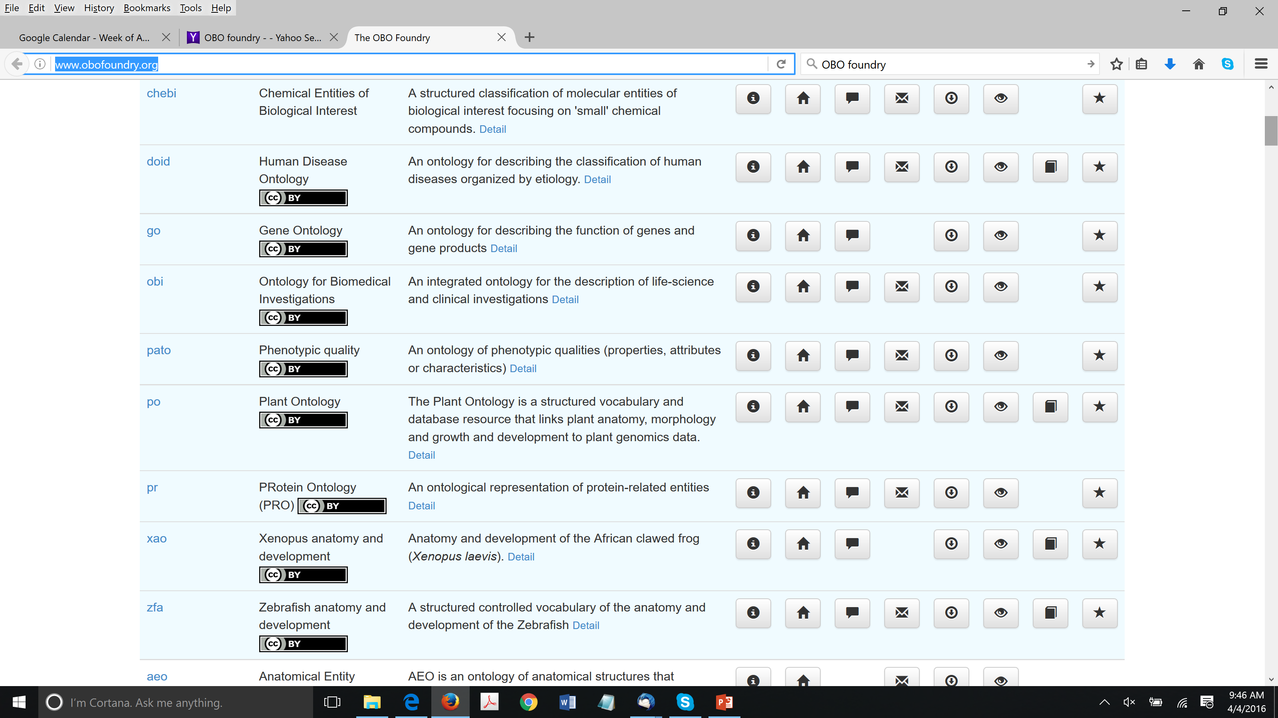
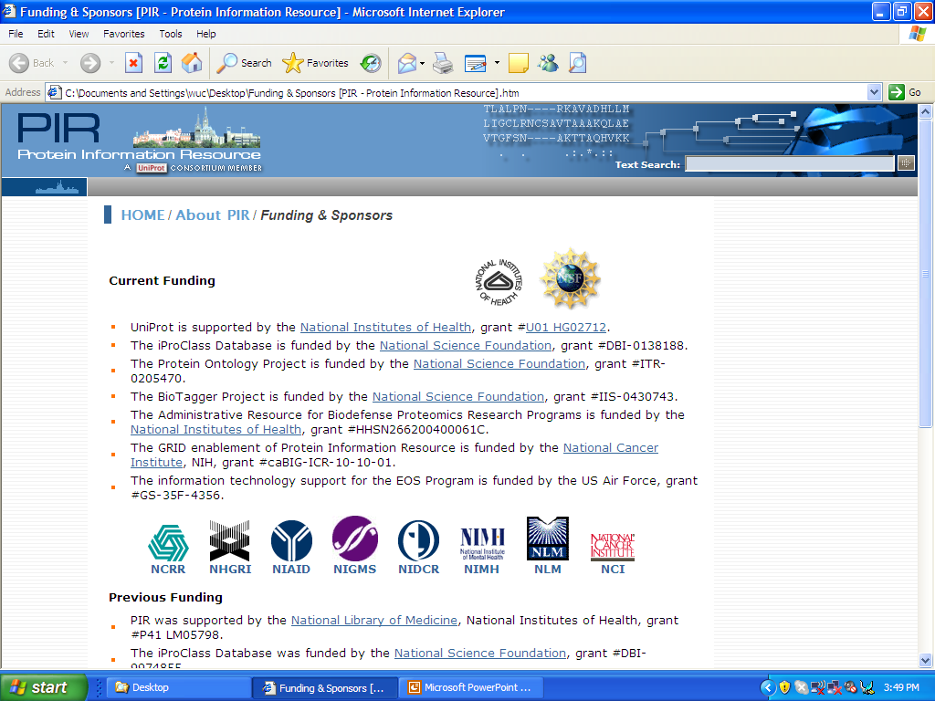

PRO in OBO Foundry
Protein Ontology (PRO)
Reference Ontology for Proteins
One of the first set of OBO Foundry ontologies
Protein Ontology: A controlled structured network of protein entities. Natale DA, Arighi CN, Blake JA, Bult CJ, et al., Wu CH. (2014) Nucleic Acids Res. 42(1), D415-421. [PMC3964965]

Slide 24
PRO Framework for Protein-Disease Understanding
PR:000027132
PTM
Enzyme
PTM Enzyme –
Modified Form
PR:Q96T88
PR:000003057
PR:P49841
PR:000037513
Subunit –
Complex
PR:000037511
PR:000037512
PR:P11309
Proteoform
PR:000037505
Related Forms
PR:000037517
PR:Q64373-1
PR:Q9P1W9
Associated
with Disease
Progression
PR:000037506
PR:000037504
PR:000026133
PTM
Proteoform
PR:P00519
DOID:162
PR:Q86V86
Associated
with Disease
Suppression
PR:P12004
DOID:10652
PR:000003237
Complex
Increased
Interaction
PR:000029189
PR:000037508
Disease
Decreased
Interaction
PR:O15350
PR:000037510
PTM-dependent PPIs and PTM cross-talks
Proteoform-specific complexes: DNMT1 proteoform in complex associated tumor suppression
Multiple levels of granularity: family level to isoform/proteoform level
Multi-relation network: proteoforms sharing common kinases, interaction partners; proteoforms implicated in the same diseases
Knowledge Representation of Protein PTMs and Complexes in the Protein Ontology: Application to Multi-Faceted Disease Analysis. Ross K, et al. (2014) ICBO 2014 Proceedings, 43-46 (http://ceur-ws.org/Vol-1327/)

Slide 25
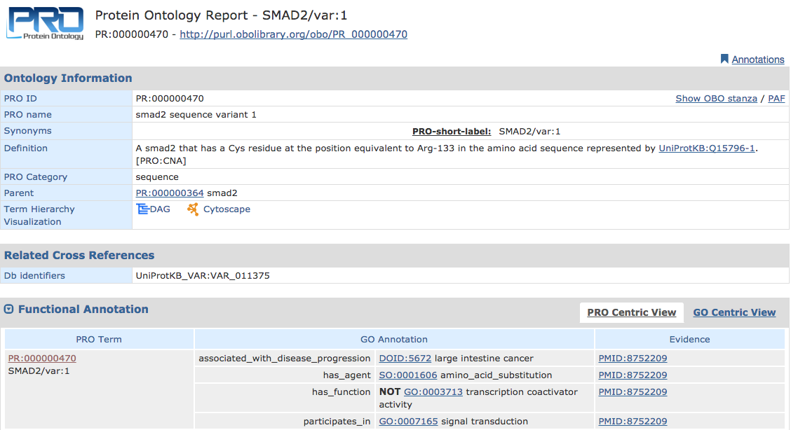


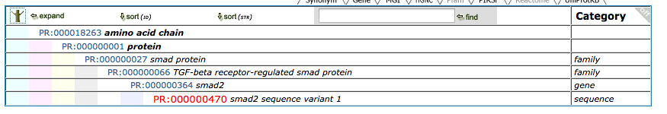

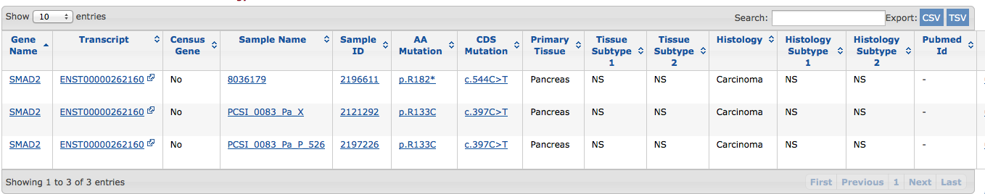
A
B
SMAD2
R133C
associated_with_disease_progression*
PMID:8752209
MADR2 Maps to 18q21 and Encodes a TGFβ–Regulated MAD–Related Protein That Is Functionally Mutated in Colorectal Carcinoma
evidence_for
is_about
Pathogenic Variant
Disease-Associated Variant
(Unknown Significance)
*or other relation terms

Slide 26
Protein-Disease Relations
Issues:
There are many protein types, alteration types, disease cause types, and extenuating circumstances
Many possible levels of knowledge of disease etiology (certainty -> uncertainty -> unknown)
Desired outcomes:
Complete list of use cases/issues to consider
Possible relations that can handle the stated use cases
Types (e.g., Causative, Facilitative, Resultive, Associative, Inhibitive)
Connections should be made at the most-precise level of specificity given the available knowledge

Slide 27
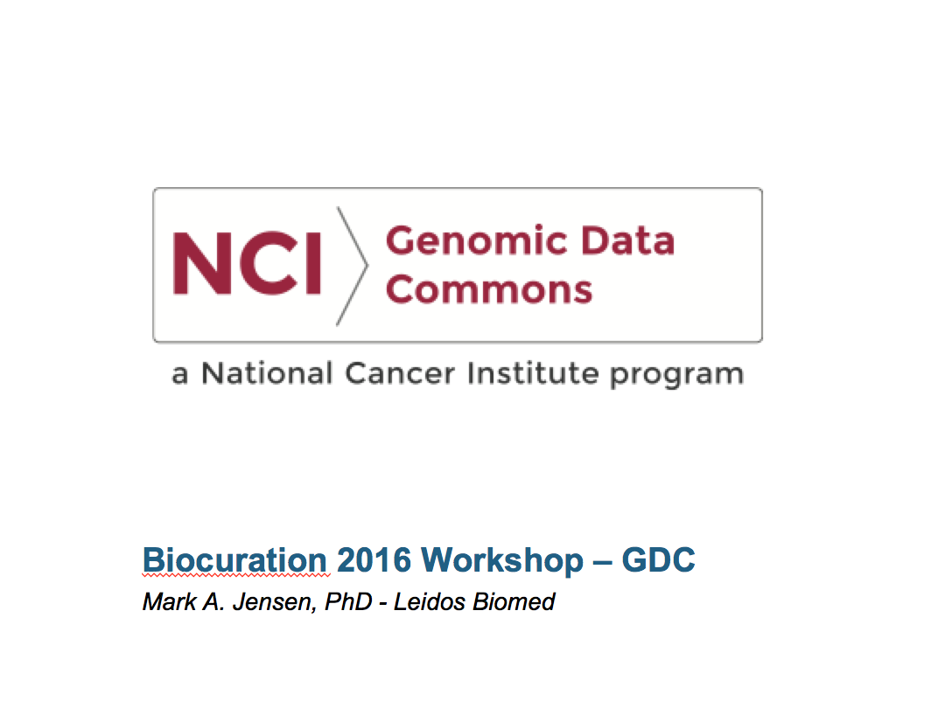

Slide 28
Resource : the NCI Genomic Data Commons
GDC: Repository for cancer genomic data linked to participant clinical data
Molecular data : DNAseq, RNAseq, miRNAseq -> Tumor-associated DNA variants, gene expression changes, copy number variation
Biospecimen data : physical sample properties, preservation method, preparation protocols, extract quality measures
Clinical data : age, gender, diagnosis, stage, disease-specific elements, clinical followup time series data
Value-added features
Scope : collect together all data from TCGA, TARGET, new and ongoing major NCI genomic initiatives (MATCH, CDDP), clinical trials and accept and integrate individual PI and smaller consortium data sets
Computation: Generate sequence alignments and derive tumor mutation, expression, copy number and other key higher level data using up-to-date, standardized, reproducible software pipelines for all submitted data
Service: Provide search, query, download, visualization tools across all datasets, projects and programs, suitable for both cancer biologists and bioinformaticians
Cost: Free to upload, free to download for all users

Slide 29
Disease Vocabularies
Primary concept vocabulary : NCI Thesaurus
Other vocabularies as needed : those integrated in the NCI Metathesaurus
Clinical questions and value domains : those collected in the NCI Cancer Data Standards Repository (caDSR)
Advantages:
Provides a head start for the initial ingestion of TCGA and TARGET project data
Encompasses both standard clinical vocabulary and research vocabulary (e.g., both standard-of-care chemotherapy agents and agents under clinical trial)
Highly curated, well resourced and maintained, product of 20 yrs of continuous development precisely within GDC scope
Excellent working relationships preexisting and continuing between GDC and NCI EVS scientists
GDC Post-Processing
Adapt semantic info fields and values to JSON Schema-based, graph-structured data model description, computable within the GDC system
Add new elements (only when absolutely necessary) to both the GDC model and to EVS with the help of EVS colleagues

Slide 30
Primary Challenge
GDC is envisioned as a service to both data submitters and data users – but the system ideals for these two user groups can conflict.
With respect to vocabulary, this tension is apparent in the GDC’s aim to:
Lower the barrier to data submission, by allowing submitters to provide clinical and biospecimen data as they have encoded it to the extent possible, and
Enable data users to create cohorts of subjects across programs and projects, or to compare their own subjects’ data to GDC-housed projects.
The extent to which GDC can meet both ideals depends on understanding and computing over synonyms between submitter vocabularies, as well as parent-child concept relationships.

Slide 31
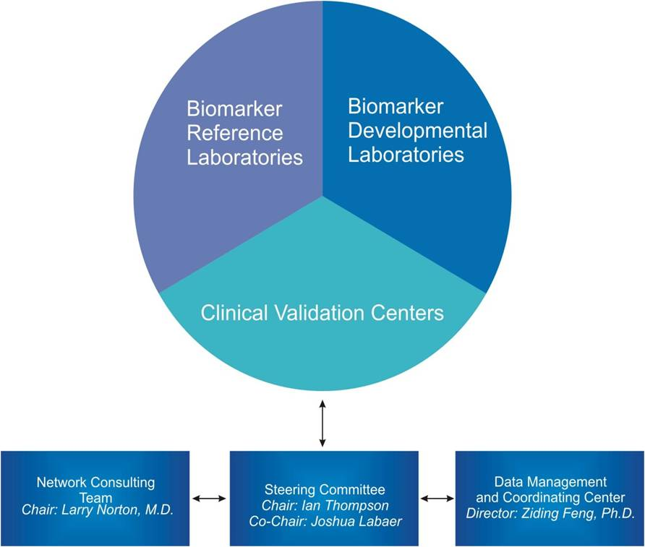
NCI Early Detection Research Network (EDRN)
The EDRN is a network of 40+ institutions all performing research geared towards the discovery and validation of prediagnostic cancer biomarkers
NCI/NIH funded program
Started in ~2000
NCI’s flagship program
Informatics efforts cited as a model for biomarker research
Collaboration across multiple groups (FHCRC, JPL, Dartmouth and NCI)
Discovery
Assay
Development
Validation
EDRN Organizational Structure

Slide 32
EDRN Biomarker Database (BMDB)
Registry of annotated biomarkers, either in development or reported in publications, offers a biomarker-centric view of EDRN research
Part of a comprehensive infrastructure to support biomarker data management across EDRN’s distributed cancer centers
Metadata-based infrastructure supports the integration of data across the EDRN (cohorts, specimens, protocols, data files and sets, biomarkers, publications):
Data from over 40 research labs; 10 organs
1000+ data elements (sufficiently described and deposited into the caDSR)
900+ biomarkers captured
200+ study protocols
1500+ publications
Multiple terabytes of data from biomarker studies archived
Policies for data capture and curation
Facilitates sharing results with the broader research community
Enriched by integration with high quality public databases (e.g. genomic, pathway, nomenclature, publication)
32

Slide 33
NCI EDRN Curation Challenges
EDRN has 40+ independently funded institutions contributing cancer biomarker data derived from their research aims
Each institution provides their own metadata to describe their research process and results
Despite the existence of an EDRN ontology, there is currently no mandate for implementation of the EDRN ontology in each research project within the consortium
EDRN curation staff must determine the origin of the metadata and perform mapping between ontologies as needed

